Slide 1
Overview of Label Propagation

Slide 2
Label Propagation
This Label Propagation only works on a small/simple dataset with one node label and one relationship label in a graph
The approach of this label propagation :
Get the starting node if one of these two conditions is satisfied:
1. Get the node that is not called.
2. Get the node that has the smallest dependencies/neighbours.
3. if any of the two conditions are not satisfied then get a random node.
Iterate the nodes with the graph value of 20, as it iterates from the starting node to the next node the graph value will decrease. The relationship value is -5 and the node value is -5. As it iterates from the starting node -> next node , it visited the relationship and then the next node thus the graph value will be 10 (20 – 5 – 5 = 10)
Keep iterating until the graph value is 0 (zero). When it is 0 the nodes that has been visited become one community.
Check if there are non-visited nodes in the graph and if yes, repeat the steps.

Slide 3
How to run:
The code of this extension is under the folder name : Label Propagation
This extension uses maven, to build a jar-file , run: mvn clean package
A jar-file will be available under the directory named “target” [\Label Propagation\target]
Stop services of Neo4j Graph database before copying the jar file to the plugin directory
Copy the jar-file named “label-propagation-20.0.jar” to the “plugin” directory of your Neo4j instance.
Restart the service of Neo4j Graph database
Refer to neo4j.log if Import-Export function does not run.
At local Neo4j you can start calling the procedure of the import-export function.

Slide 4
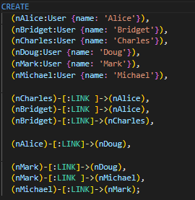
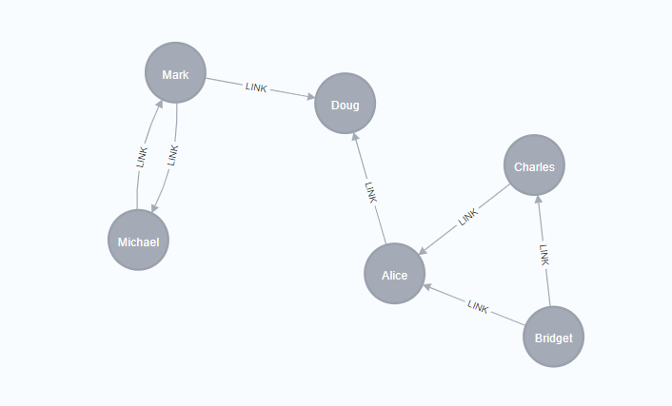
Example:
A dataset example
Running the dataset in local Neo4j will give this output graph

Slide 5
Label Propagation:
The label propagation will give an output of a new graph containing community nodes, under the label “Community”.
Procedure: CALL LabelPropagation(“NodeLabel”, “RelsLabel”)
Example: CALL LabelPropagation(“User”, “LINK”)
A successful run of the query will give an output message of “Create new nodes under ‘Community’ successfully”
A new graph containing the community nodes and the nodes that corresponds to a specific community nodes.

Slide 6
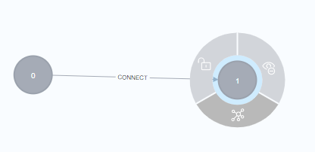
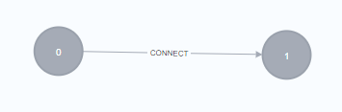
Output of Label Propagation:
From the output we can see that there are two communities present from the graph.
By clicking the ‘show relationship’ button we can see the nodes that corresponds to the community node.

Slide 7
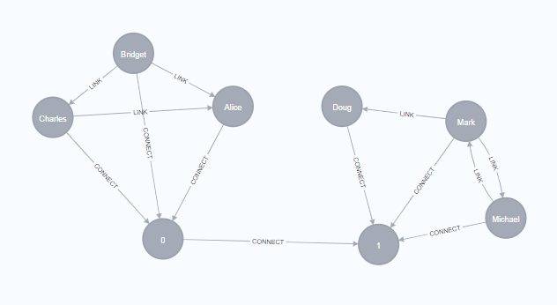
Output of Label Propagation:
By clicking the ‘show relationship’ of the nodes we can see the nodes corresponding to the community nodes.
Here we can see the nodes [Charles, Bridget, Alice] are in community 0 and [Doug , Mark, Michael] are in community 1.

